Slide 1
October 2025 (CY 4) Weekly Report
Polomolok Biogas Plant
October 1-31, 2025

Slide 2
Substrate Supply
CY4 Delivered:
Oct: 35% of monthly minimum SCA reqt.
YTD: 33% annual minimum guaranty

Slide 3
Biogas Conversion (Yield)

Slide 4
Biogas Conversion (Yield)

Slide 5
Biogas Utilization
CY4 Delivered:
Oct: 37% of monthly minimum SCA reqt.
YTD: 32% annual minimum guaranty

Slide 6
Power Generation
Y4 Delivered:
Oct: 17% of monthly minimum SCA reqt.
YTD: 30% annual minimum guaranty

Slide 7
Oct Wk5 Updates
4 out of 6 canning days for this week
Fresh mass feeding is at 327-364 MT per day.
Gas production is averaging at 1250 Nm3/hr
Gas Quality: US : CH4 – 52.2% CO2 – 45.9% O2 – 0.0% H2S – 0ppm
DS : CH4 – 53.0% CO2 – 46.7% O2 – 0.0% H2S – 0ppm
Fermenters | pH (7.00 – 7.50) | FOS/TAC (0.3 – 0.5)
F1 | 7.19 | 0.23
F2 | 7.10 | 0.13
F3 | 7.13 | 0.21

Slide 8
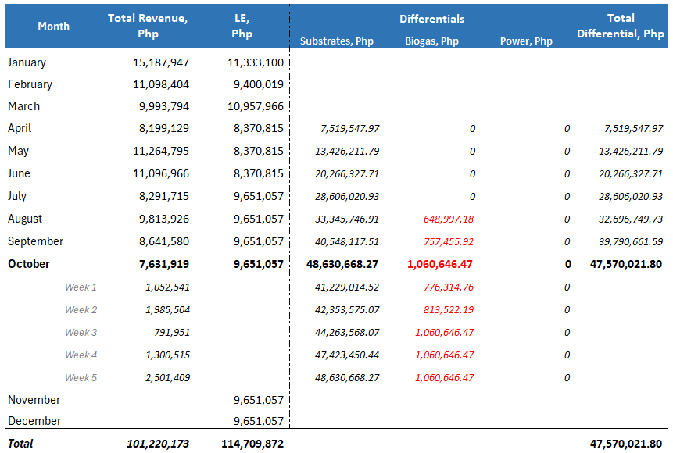
Revenue Tracking

